Slide 1
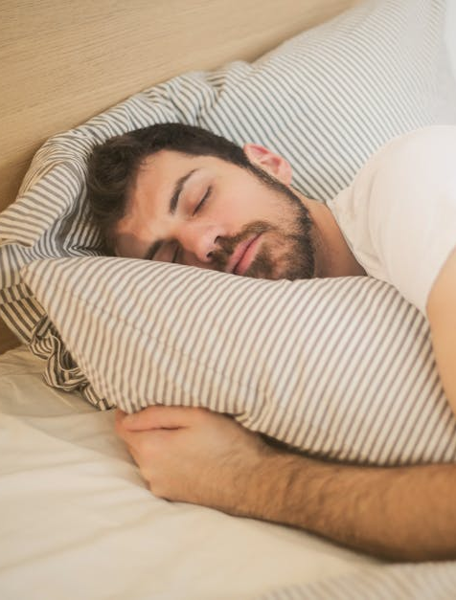
Predictive Modeling for Sleep Disorders
Data-Driven Insights for Early Detection
1/15

Slide 2

Problem Overview
IMPACTS ON HEALTH AND WELL-BEING
Sleep disorders have an increasing impact on mental and physical health and are a developing global concern.
Causes include environmental variables, stress, food, and lifestyle choices.
Early detection of these variables can enhance sleep hygiene and lower health risks.
Analyzing trends and providing early detection of sleep disorders, a predictive model built on routine data could facilitate diagnosis and enable preventative intervention.
Model would provide a more workable approach to enhancing sleep and general well-being.
More affordable than conventional diagnostic techniques.
2/15

Slide 3
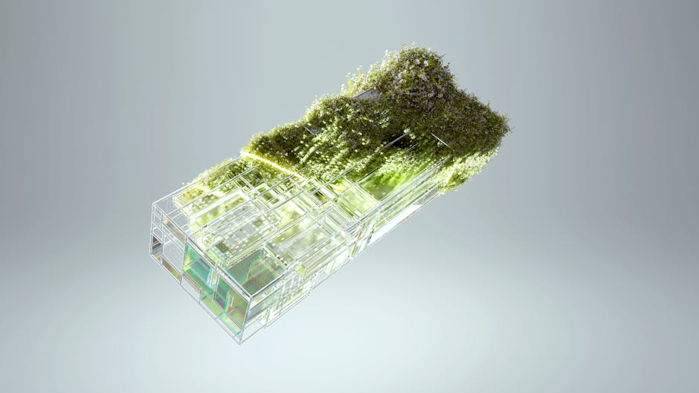
Innovative Approaches
DATA-DRIVEN PREDICTIONS
Using algorithms, diverse lifestyle metrics can predict sleep disturbances, allowing for timely interventions to improve sleep hygiene.
PERSONALIZED RECOMMENDATIONS
Tailored advice based on user data enhances individual health strategies, reducing the risk of developing sleep disorders.
3/15

Slide 4
Tech Stack Overview
The technology stack enables the successful development and deployment of sleep disorder prediction models. Each component plays a critical role in the overall solution.
COMPONENT | PURPOSE
IDE | VS Code for development
Data Visualization | Matplotlib and Seaborn for visualizing data
ML Algorithms | Random Forest, XGBoost, neural networks for predictions
Cloud Computing | Streamlit, AWS, Google Cloud for deployment
Version Control | Github for version management
APIs | APIs from wearable devices for data integration
4/15

Slide 5
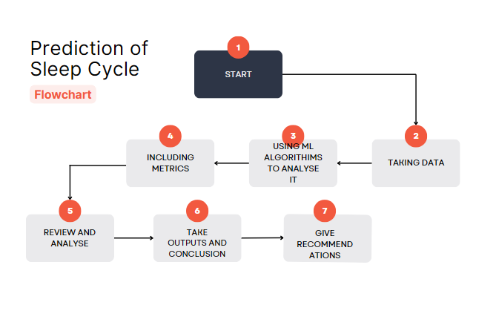
5/15

Slide 6
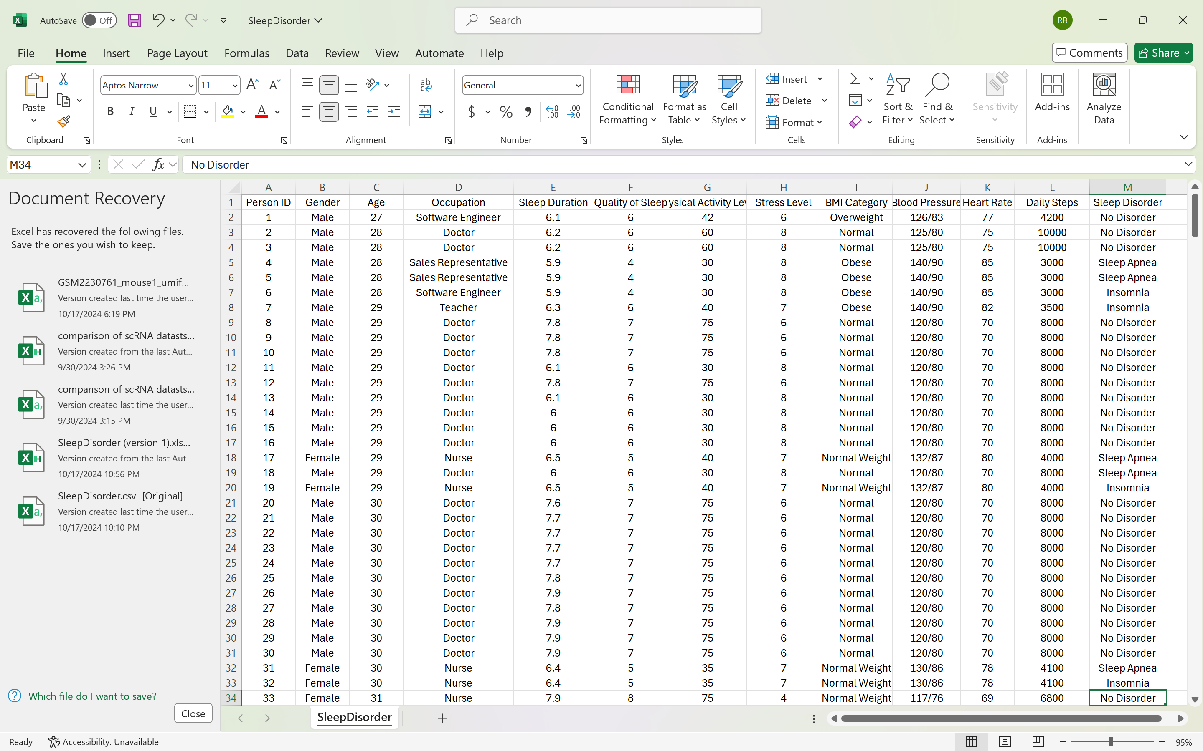
The Dataset
Snashop of the dataset used in the project
Contains both numerical and categorical variables
Last column is ‘Sleep Disorder’ which denotes label for each sample
Variables include age, occupation ,sleep duration, stress level etc.
6/15

Slide 7
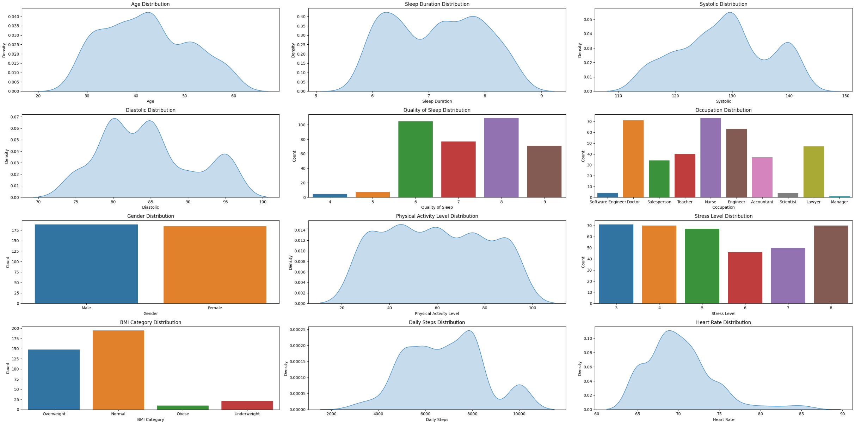
Distribution of different Variables
7/15

Slide 8
Analyzing Plots
Visually analyzing the previous plots we can say the following:
Age Distribution: Most individuals are between 30-50 years old, with a peak around 40.
Sleep Duration: A bimodal distribution with peaks around 6 and 7 hours of sleep.
Blood Pressure: A slightly right-skewed distribution for systolic pressure with peaks around 130, while diastolic has multiple peaks.
Quality of Sleep: Categorical data, with most individuals rating their sleep quality as 6, 7, or 8.
Occupation: Nurse, engineer, and salesperson are the most common occupations, while software engineers and scientists are underrepresented.
Gender: Even distribution of male and female participants.
BMI Categories: Most individuals fall in the "Normal" category, followed by "Overweight" and fewer in "Obese" and "Underweight."
Physical Activity Level: The distribution peaks between 60-70 units, indicating moderate activity levels.
Daily Steps: A peak at 6,000-8,000 steps, showing moderate step counts.
Stress Levels: Most participants report stress levels between 3 and 4, with a gradual decline as the stress level increases.
Heart Rate: A peak at around 70 bpm, indicating typical resting heart rates.
8/15

Slide 9
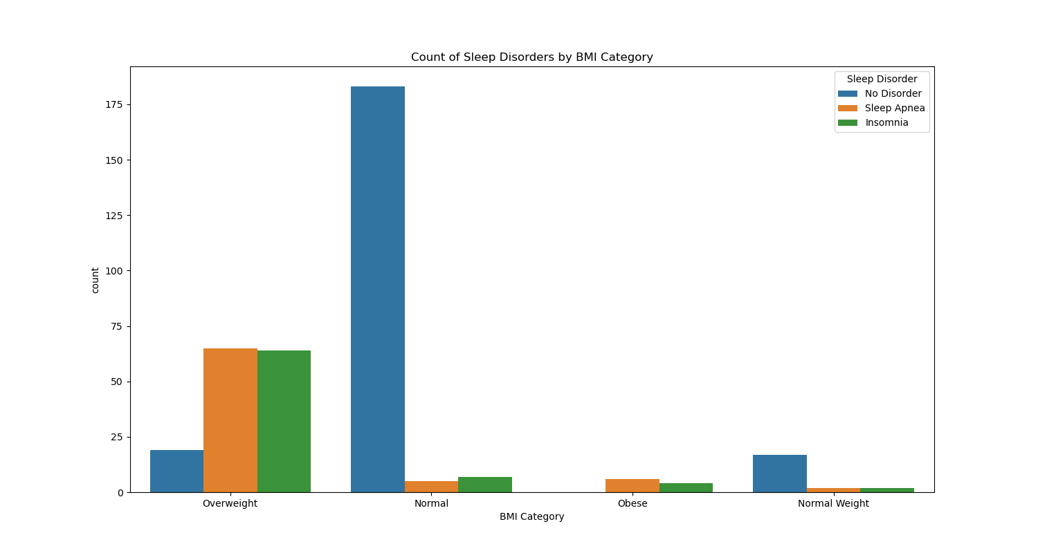
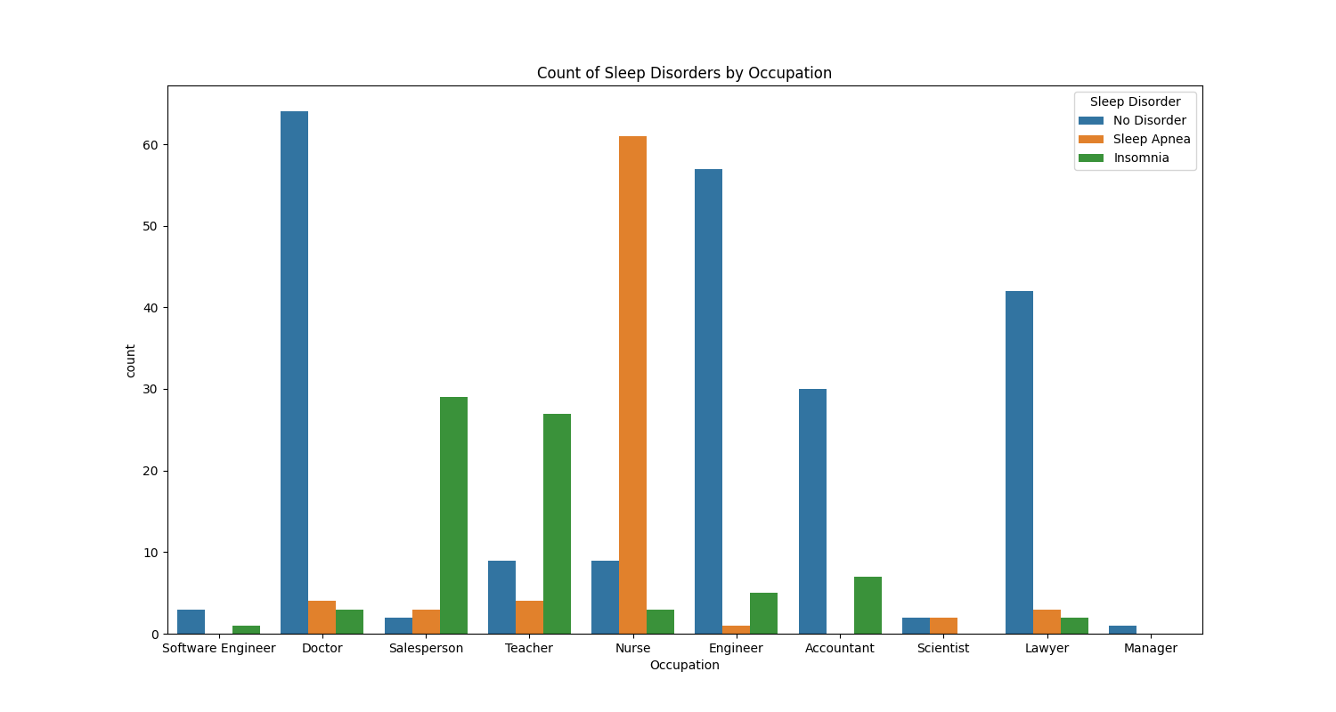
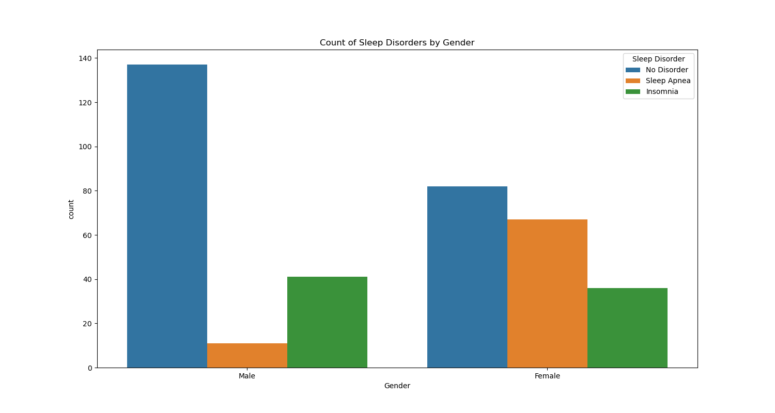
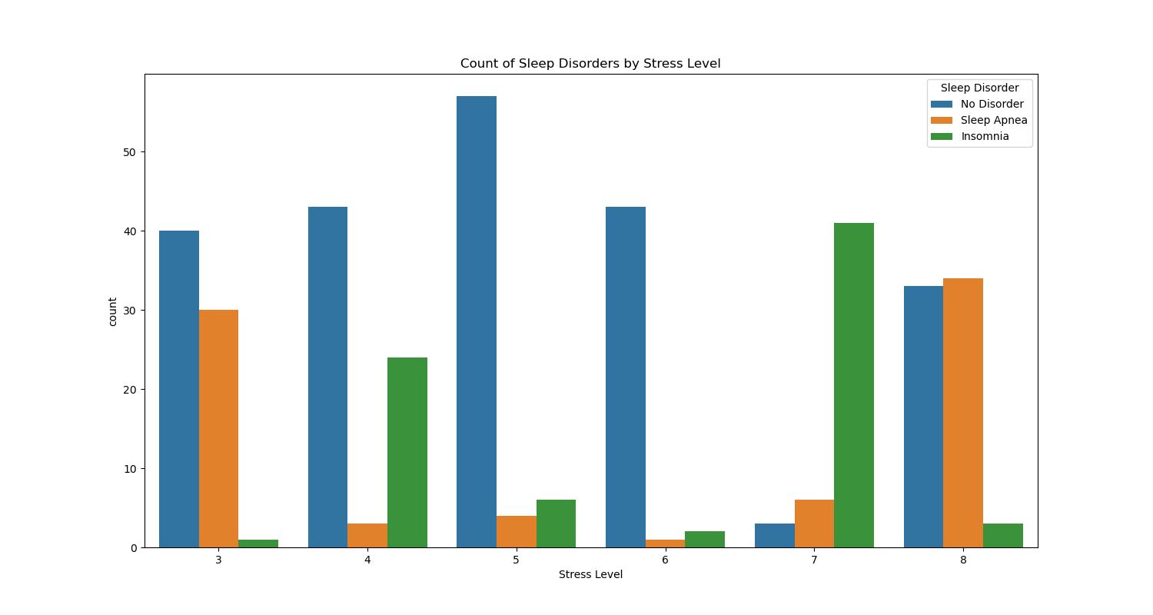
Count of categorical variables wrt labels
9/15

Slide 10
Analyzing Plots
Visually analyzing the previous plots we can say the following:
BMI category (and so weight) is an important factor for analysing sleep disorders. The more the BMI, the chance of having sleep disorder also increases.
Since different occupation have different working condition, stress level so it also affects the sleeping cycle. It seems from the data that Salespersons and Teachers have higher probability of having Insomnia, whereas Nurses have relatively higher chance of having Sleep Apnea.
Since the data is almost uniformly distributed between gender, it seems from third plot that females are more prone to sleep disorders.
From fourth plot it seems there isn't direct correlation between stress level and sleep disorders. However, sress level is connected to sleep disorders through other variables like occupation, age.
10/15

Slide 11
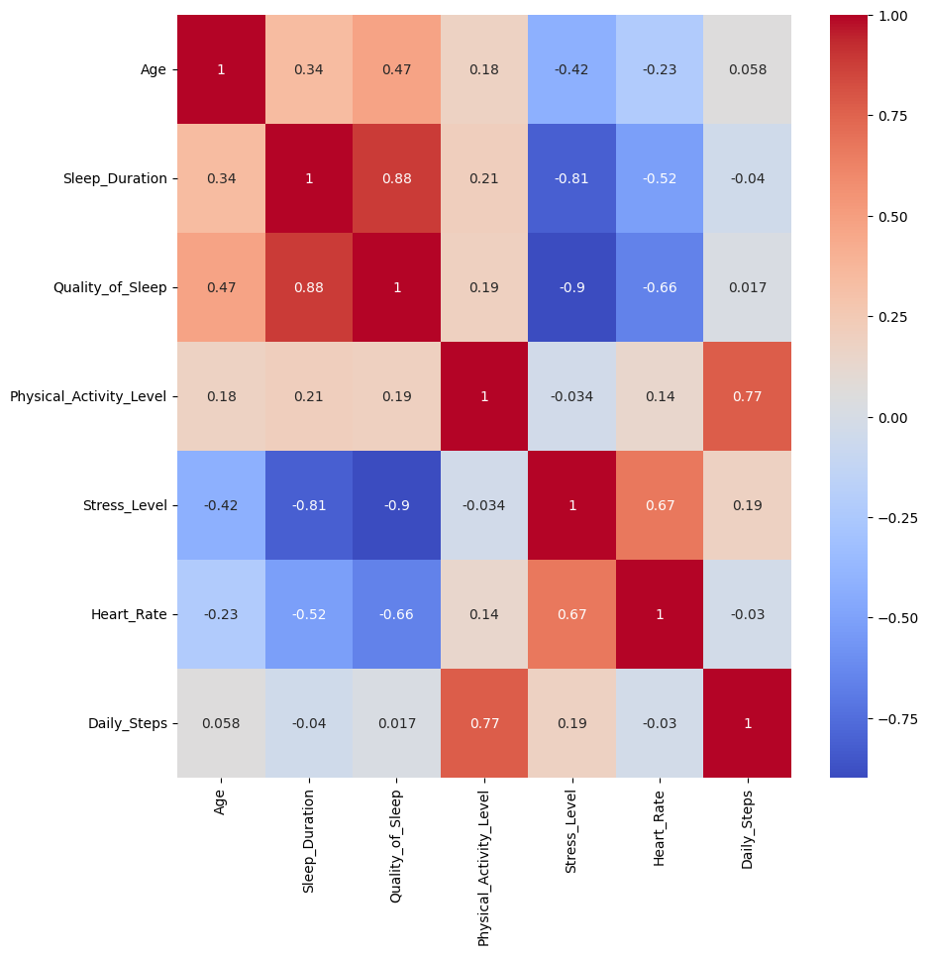
Confusion Matrix
11/15

Slide 12
Preprocessing of Data
Encoder
Normalization
Data Split
LabelEncoder and OneHotEncoder is used to transform categorical data to ordinal and one-hot numeric values
StandardScalar from sklearn package is used for z-score normalization of the data
80% data is used for trainind the model, and other 20% is used as testing data
12/15

Slide 13
Classification Model
MODEL DEVELOPMENT
ACCURACY ASSESSMENT
Procedure
Three different machine learning tools are used to develop the predictive model: Decision Tree, Random Forest, KNN Classifier.
The performance of models is continuously evaluated using metrics such as: Accuracy, Precision, Recall for different classes.
For each model the training data along with their labels are used to learn the patterns of data. Then remaining data is used to test the model.
For fine tuning, Grid search Cross Validation is used
13/15

Slide 14
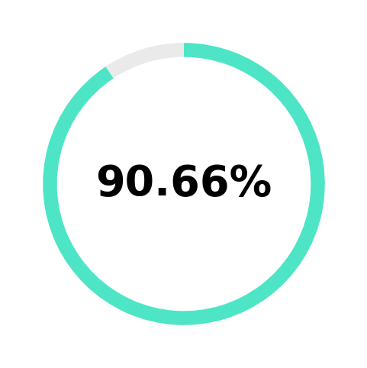
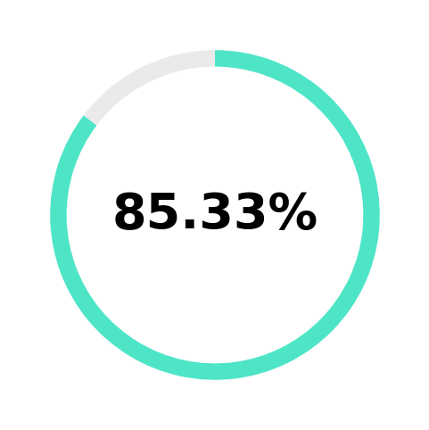
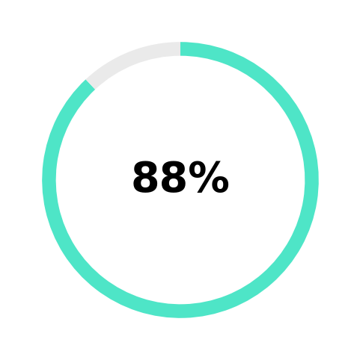
Performance of Models
Accuracy Score:
Decision Tree
KNN Classifier
Random Forest
The Best Classifier of our data
14/15

Slide 15
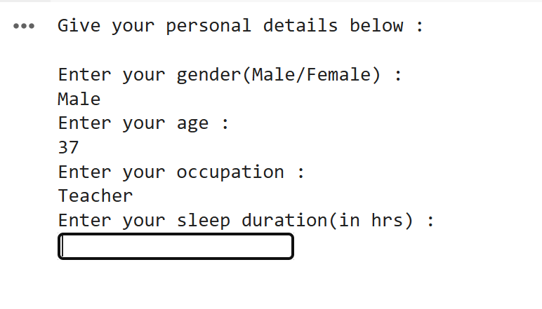
Prediction
Prediction of sleep order for new sample
Based on the given inputs, the model can predict the sleep disorder of individuals.
A sample of interface is shown beside

Slide 16
Conclusion & Future Scope
TOWARDS ENHANCED CONTINUOUS HEALTH MONITORING
By integrating sleep predictions with other health data, we can create comprehensive health assessments, identifying correlations with conditions like diabetes, heart diseases and brain diseases.
In future these data can be collected in real time from smart devices like watch,band or mobile, which in term will help to be updated about health issues
15/15

